Slide 1
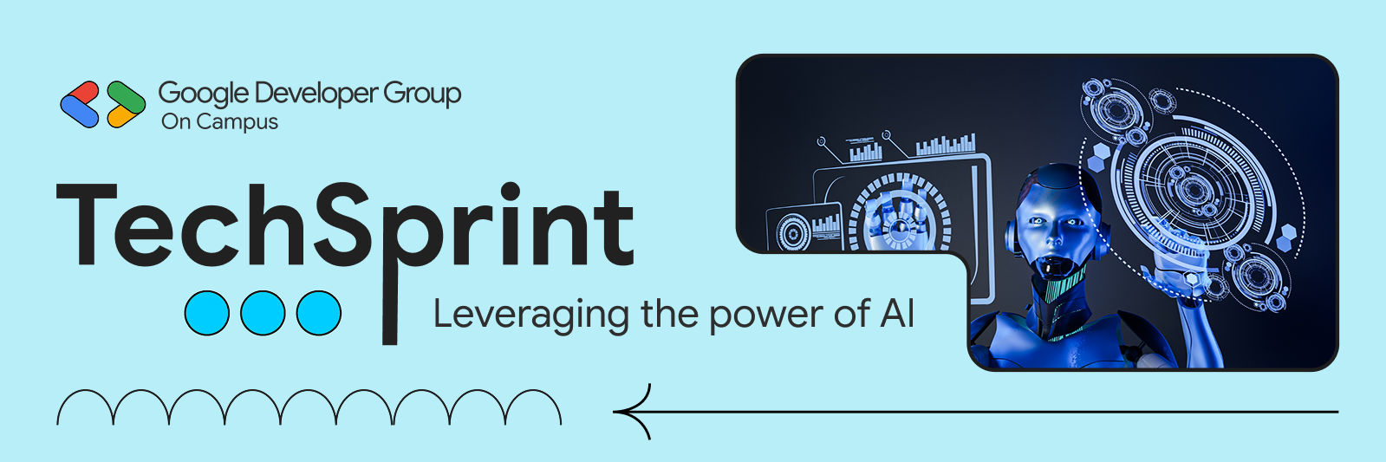
Team Details
  Team name: Code Drafters
  Team leader name: R.Sandhya Rani
  Problem Statement: Open Innovation

Slide 2

Problem Statement
Many users find it difficult to create and manage websites due to lack of technical knowledge, time constraints, and high development costs. Existing solutions are often complex and not user-friendly.
Solution
This solution provides an AI-powered, easy-to-use website that enables users to create, customize, and manage content without coding. It offers responsive design, simple navigation, and quick updates, making website management efficient and accessible.

Slide 3
Opportunities
This solution creates opportunities for students, small businesses, and individuals to build a professional online presence quickly and affordably. It encourages digital growth by making website creation accessible to non-technical users.
How is it different from existing ideas?
Unlike traditional website builders, this solution uses an AI-driven approach that generates layouts and content based on user input. It reduces manual effort and simplifies the entire website creation process.
How will it solve the problem?
The solution eliminates the need for coding, reduces development time, and provides easy content management. This helps users create organized, responsive, and user-friendly websites efficiently.
Unlike traditional website builders, this solution uses an AI-driven approach that generates layouts and content based on user input. It reduces manual effort and simplifies the entire website creation process.

Slide 4
Features Offered by the Solution
AI-Powered Website Creation
User-Friendly Interface
Responsive Design
Customizable Templates
Fast Deployment
Secure Platform

Slide 5
Google Technologies used in the solution
Gemini AI
Fire Base
Google AI
WIX AI

Slide 6
Architecture diagram of the proposed solution
User
|
v
Web Browser (UI)
|
v
AI-Powered Website (Wix Vibe)
|
|----> Gemini AI (Content & Design Assistance)
|
|----> Firebase (Authentication, Data Storage)
|
v
Published Website

Slide 7
Additional Details / Future Development
In future versions, the website can integrate advanced AI models to generate personalized content based on user behavior.
Firebase Analytics can be used to monitor user activity and optimize performance.
Multi-language support and role-based authentication can be added to improve accessibility and security.
The system can also be scaled by integrating cloud services and APIs for better performance and reliability.

Slide 8
Links :
GitHub Public Repository:
https://github.com/jyo02-R/HireReady1.git
Demo Video Link (3 Minutes):
https://youtube.com/shorts/LynzsF9tnHc?si=_ctKsyaqShd54X3h
MVP Link:
https://my-site-faawe4wl-rjyothsna2007.wix-vibe.com/

Slide 9
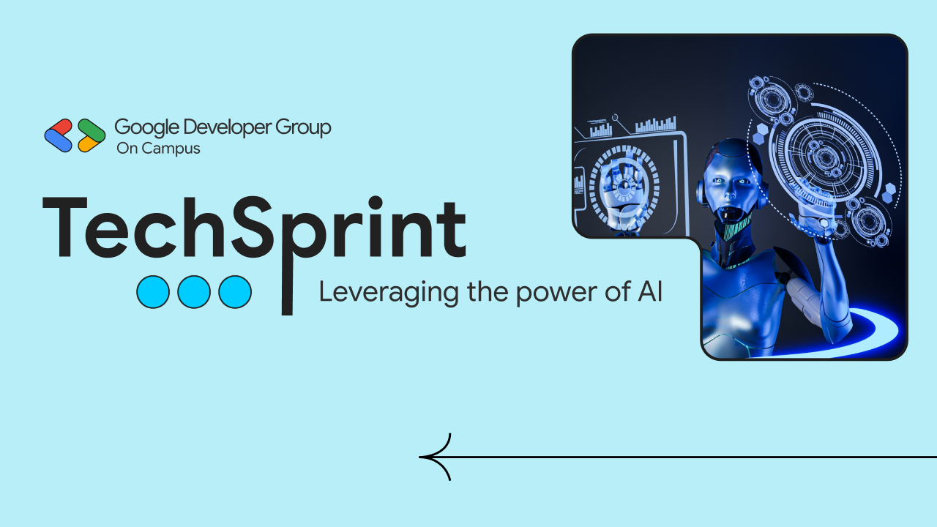
Thank you!

